Slide 1
Spelling Assessment completed on 11/10/14 Student: Ellen Grade: 1st Grade
Examiner:
Hailey Borkowski

Slide 2
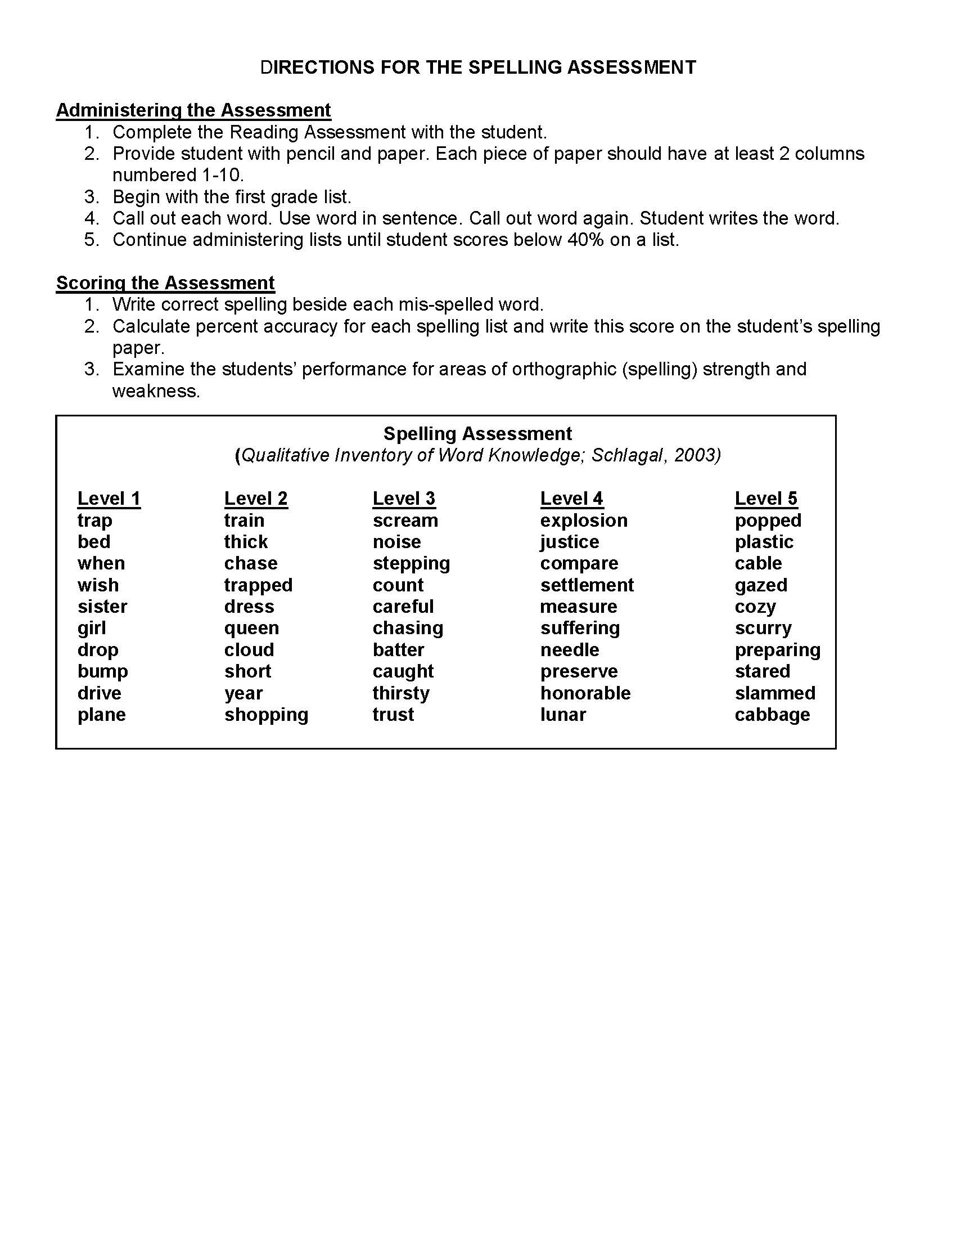

Slide 3
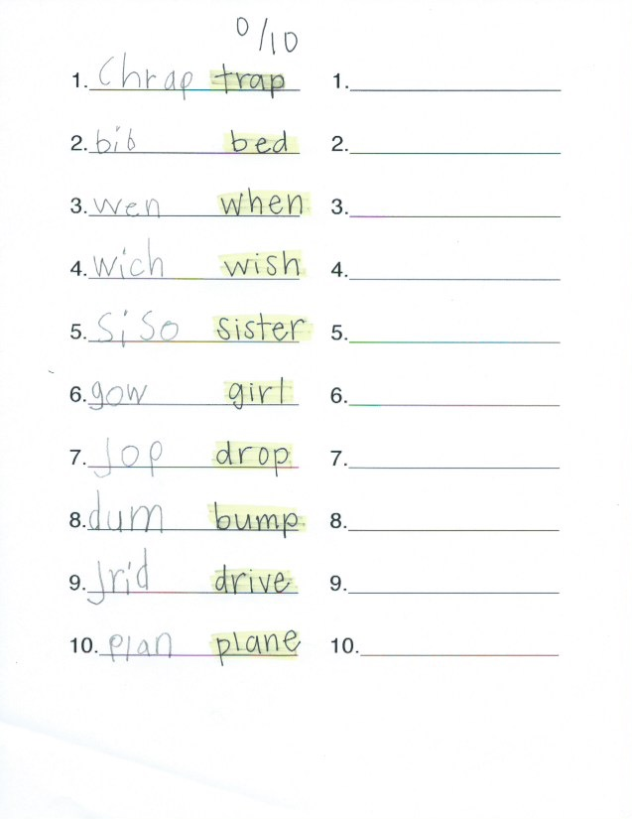
Spelling Assessment Administered on 10/29/14

Slide 4
Stage of Spelling Development:
Late Letter Name
Justification of Stage
What student is doing correctly:
Ellen is currently writing her initial consonants and most of the final consonants correctly. She has vowels in most of the syllables. I only used the first list, so all of the words except ‘sister’ were single syllable. Ellen tries to use the correct medial vowel in all of the words. In the initial spelling assessment, she had all of the correct medial vowels except in ‘bed’ and ‘girl’. She still struggles with the letters b and d when trying to represent them in words. For example, she wrote bib for bed.
What student is “using but confusing:”
Ellen doesn’t have much that she is “using but confusing”. She has more features that are either correct of absent. Surprisingly she had most of the correct short vowels in the initial spelling test, except for the e in sister (she said siso) and the i in girl (she said gow). She did have logical short vowel substitution whenever she wrote the word bed she wrote bib instead. She substituted the i for the e. She also still has trouble with directionality involving b and d as seen in her version bed as well. Ellen is also using but confusing consonant blends (jrid for drive and chrap for trap) and digraphs (wich for wish). Finally, Ellen has yet to master pre-consonant nasals (dum for bump). All of these features are typically acquired before the student leaves the Late Letter Name Stage.

Slide 5
Appropriate Level of Spelling Instruction:
Short Vowel Sort
DAD
HIT
TOP
HAT
KID
FOX
NAP
WITH
DOLL
PASS
THIS
ROCK
BACK
SWIM
CHOP
Justification of Sort
I am using this sort because Ellen needs to work on her medial vowels. I started with “a”, “i”, and “o” to work with Ellen. These will help her master these sounds so that she can work on her blends and digraphs to help her fluency in spelling. I think that once she mastered the these words she could move on to the a,i,o sorts that have the blends and digraphs. She has acquired initial and final consonant awareness already and it was appropriate to try and master her medial vowels. The words I used had the same rime at the end of each word to help Ellen match the words based on the pattern she would see in each column.

Slide 6
Day One
Instructional Activities
Sort
dad hit top
back kid fox
nap with doll
hat swim rock
pass this chop
Concentration
Spell Check
Observations:
I used dad, hit, and top as the headers for the sort I did. I thought these would be an easy start for Ellen to recognize these words. She was able to identify these words easily when I asked her. I modeled one word for her and once she saw what I did, she was able to put all the words in the correct column. She struggles with the word chop. She would say cop. I noticed in class she struggled with the digraph “ch”. She also had trouble reading dad. She kept saying bab or bad instead. Every time we read down the column and did concentration she struggled with this word. Ellen beat me in concentration! She really liked getting matches and winning. I chose the following words for the spell check: hit, dad, top, hat, swim, fox, chop, back, and this. Ellen made three errors, two on short “a” words: dab (for dad) and bac (for back). The other mistake was cop (for chop). Her main errors were digraphs and b-d substitutions.

Slide 7
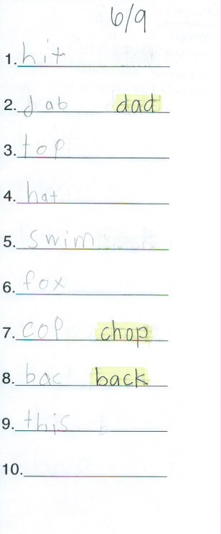
Spell Check from Day 1

Slide 8
Day Two
Instructional Activities
Sort
dad hit top
back kid fox
nap with doll
hat swim rock
pass this chop
Concentration
Spell Check
Observations:
I used the same headers on day two since she couldn’t pronounce some correctly and missed some words on the spelling check. I didn’t need to model the sort again because she remembered how we did it on day 1. I had her read the headers back to me again and she read them correctly. She did the word sort perfectly again. She still struggled with dad, doll, and kid a few times. Other than that she read the other words correctly. I think she still could have said them a little quicker than what she was doing. She still struggled with chop, saying it was cop. Ellen beat me again in concentration. I chose the same words that I used yesterday for the spell check: doll, fox, hit, swim, back, top, nap, kid, dad, and I threw in chop as an extra credit one to see if she could get it. Ellen only made 2 errors this time. She still missed back (she said bac) and then she missed doll (she said ball). I was surprised she spelled chop correctly!

Slide 9
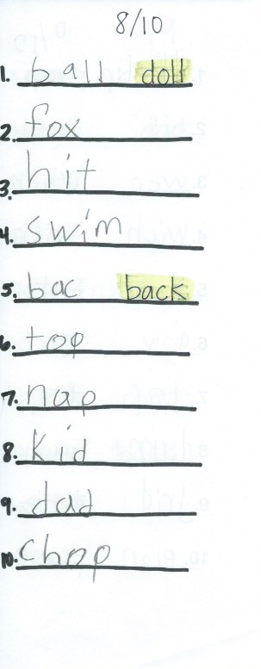
Spell Check from Day 2

